Slide 1
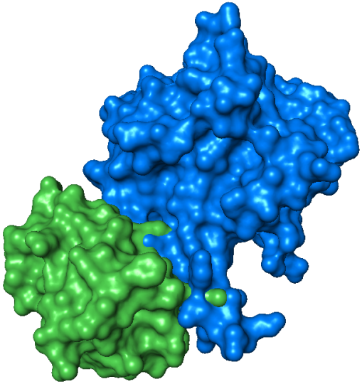
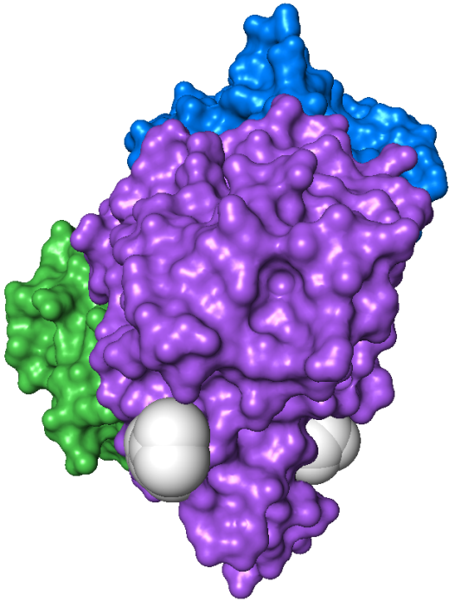
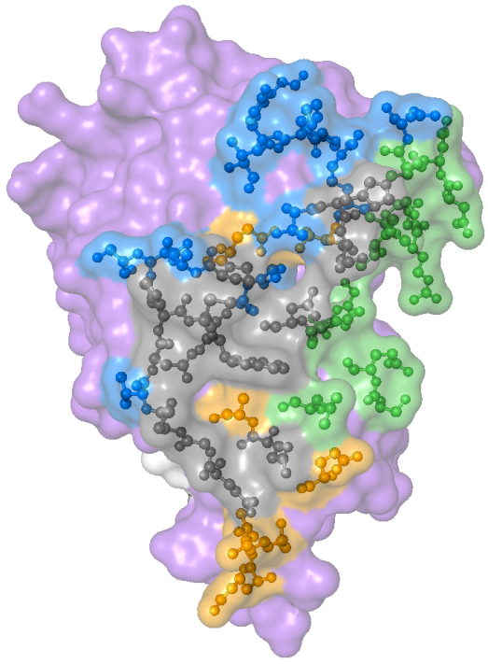
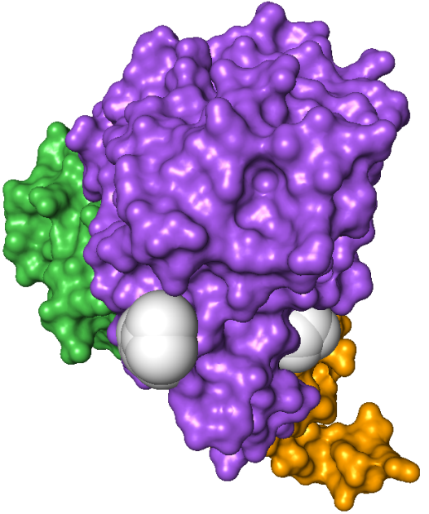
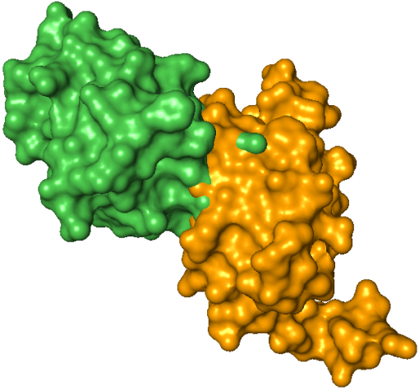
NanE
NanE
Binding sites on NagB:
HPr
HPr
NagB
M223
D165
NagB
N221
W224
W224
NagB can bind either HPr + NanE or HPr + U-PII simultaneously
N
C
HPr
Interface shared by NanE and U-PII
Inter-subunit contacts
Inter-trimer contacts
Key residues are indicated
NagB
HPr
Quaternary structure of NagB:
U-PII
x3
x2
Hpr, NanE, U-PII combined interface

